Slide 1
DSCI-531: FAIRNESS IN ARTIFICIAL INTELLIGENCE BIASES IN NLP: APPLICATIONS
Keith Burghardt
February 26, 2024

Slide 2
Is it possible to discriminate through text and language?
Can AI eliminate human bias from decisions?
Algorithms are only as good as the data they were trained on
Data reflects explicit prejudices …
… implicit biases in society
… patterns of discrimination, exclusion and inequality
“Unthinking reliance on data mining can deny historically disadvantaged and vulnerable groups full participation in society”
[Barocas, S., & Selbst, A. D. (2016). Big data's disparate impact. Calif. L. Rev., 104, 671.]

Slide 3
Explicit and implicit bias
prej·u·dice
preconceived opinion (usually negative) that is not based on reason or actual experience.
Explicit bias
the person is aware of their feelings and attitudes, and intentional in behaviors; Characterized by prejudice expressed through physical and verbal actions. E.g., “Women who are mothers are not serious about their research.”
Implicit bias
Learned attitudes or stereotypes that exist in our subconscious and can involuntarily affect the way we think and act. E.g., Not inviting female researchers into research collaborations.”

Slide 4
A father and son get in a car crash and are rushed to the hospital.
The father dies.
The boy is taken to the operating room and the surgeon says,
“I can’t operate on this boy, because he’s my son.” Can you explain why?
https://www.youtube.com/watch?v=J69HkKz9g4A
2

Slide 5
Language & Bias
Language implicitly transmits ingroup/outgroup identify information, leading to human prejudices
Language models (e.g., word embeddings) encode stereotyped biases in addition to other knowledge, including how flowers are pleasant and the gender distribution of occupations.
Behavior can be driven by cultural history embedded in language, and can vary between languages.
Creating a feedback loop
Bias enters data in other ways, e.g., demographics, test scores, …

Slide 6

Flowers

Slide 7
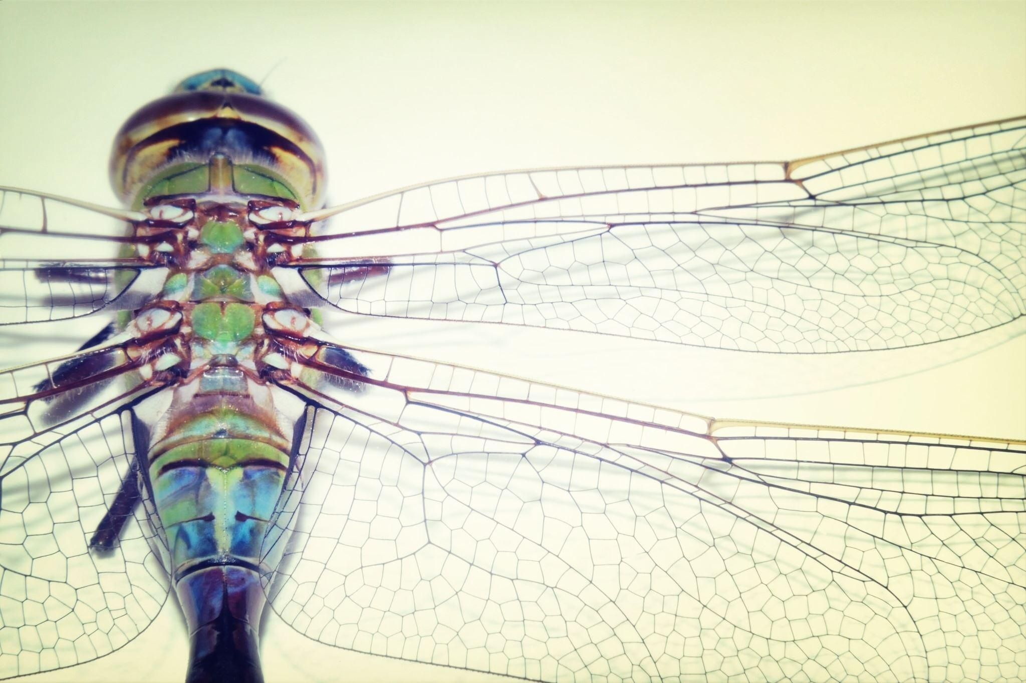
Insects

Slide 8
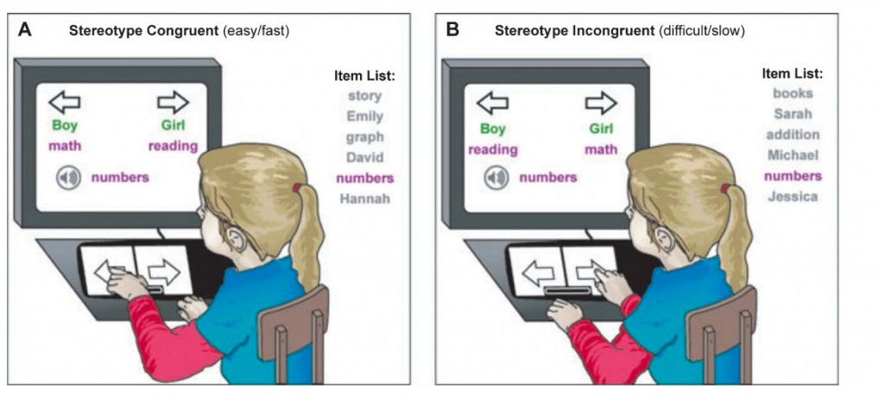
Implicit association test (IAT)
https://implicit.harvard.edu/implicit/

Slide 9
Implicit association test (IAT)
Implicit Association Test (IAT) used by psychologists to measure implicit prejudices and stereotypes
IAT measures differences in response times when subjects are asked to pair two concepts they find similar, in contrast to two concepts they find different.
Response times are faster when tasks are easier: e.g., subjects are much quicker if they are told to label insects as unpleasant and flowers as pleasant than if they are asked to label these objects in reverse

Slide 10




It is easier (quicker) to associate some concepts together than others
Liberal arts
Liberal arts
vs

Slide 11
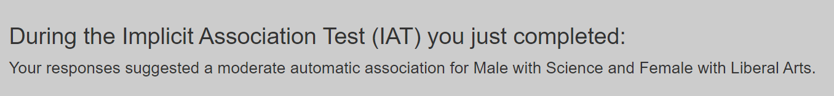
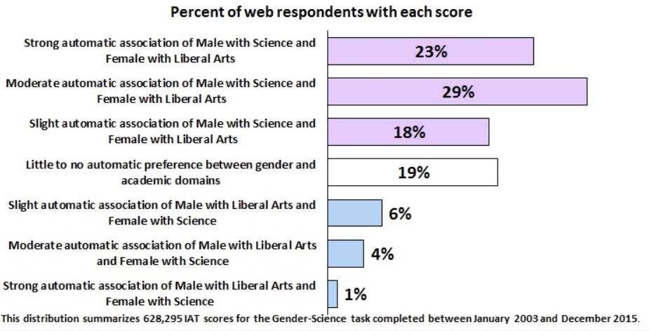

Slide 12
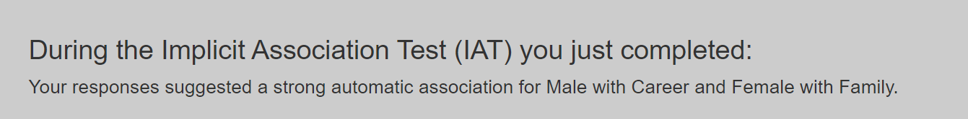
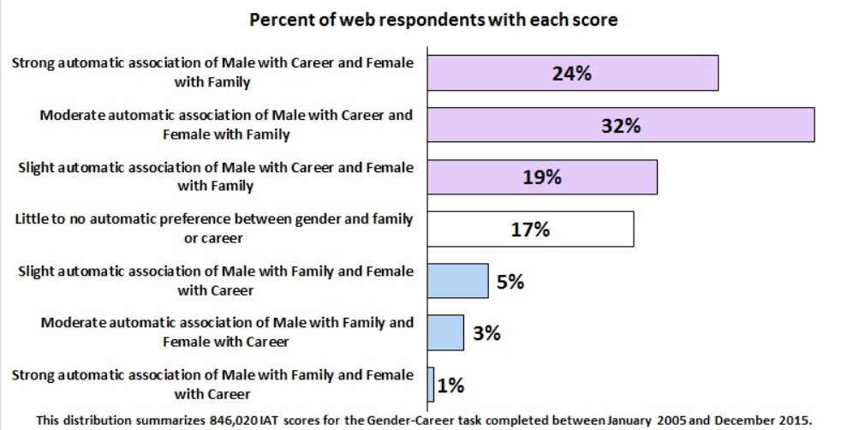

Slide 13
What are some of the consequences of gender bias?
Harms
Perpetuates inequality. Create a feedback loop to keep bias going
Affect decision making e.g., hiring discriminates against women
Lack of income parity
Harm product quality
“Benefits”
Beneficial to the other class
Targeted marketing
Greater social cohesion

Slide 14
Gender bias in healthcare
Gender bias creates unintended but systematic neglect of women’s health and well-being.
Medical conditions, such as coronary artery disease, Parkinson's disease, irritable bowel syndrome, and tuberculosis, men are investigated and treated more extensively than women with the same severity of symptoms.
older women were less likely than older men to be admitted to ICUs or receive life-saving interventions.
Physicians are more likely to interpret men's symptoms as organic and women's as psychological
Historically clinical trials were performed mainly on young or middle-aged white men
Recommendations about treatments and drugs are based on studies where the majority of participants were men
Notes:
https://journals.sagepub.com/doi/10.2217/17455057.4.3.23

Slide 15
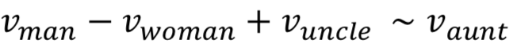
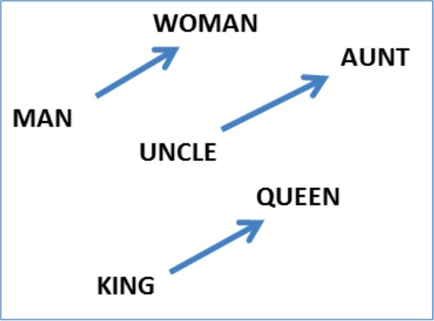
Word Embeddings can be Dreadfully Sexist
he: | she:
brother | sister
beer | cocktail
physician | registered_nurse
programmer | homemaker
professor | associate professor
Use Google w2v embedding trained from the news (Glove)

Slide 16
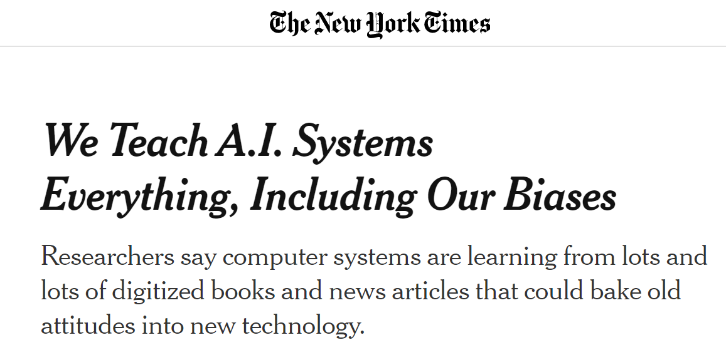
What about language models?
Caliskan, A., Bryson, J. J., & Narayanan, A. (2017). Semantics derived automatically from language corpora contain human-like biases.
Language models acquire stereotypes from text that reflect human culture
Cultural stereotypes propagate into applications using these models
WEAT – Word Embedding Association test to measure implicit bias of AI
https://www.nytimes.com/2019/11/11/technology/artificial-intelligence-bias.html

Slide 17
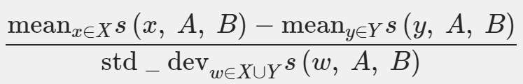
WEAT
Use word embeddings to measure distance from attribute words (A/B: e.g., flowers/insects) to target words (X/Y: e.g., pleasant/unpleasant)
The null hypothesis is that there is no difference between the two sets of target words in terms of their relative similarity to the two sets of attribute words.
The permutation test measures the (un)likelihood of the null hypothesis by computing the probability that a random permutation of the attribute words would produce the observed (or greater) difference in sample means.
The effect size is a normalized measure of how separated the two distributions (of associations between the target and attribute words) are:

Slide 18
Which concepts are closer in the embeddings space?
Flowers: aster, clover, hyacinth, marigold, poppy, azalea, crocus, iris, orchid, rose, bluebell, daffodil, lilac, pansy, tulip, buttercup, daisy, lily, peony, violet, carnation, gladiola, magnolia, petunia, zinnia.
Insects: ant, caterpillar, flea, locust, spider, bedbug, centipede, fly, maggot, tarantula, bee, cockroach, gnat, mosquito, termite, beetle, cricket, hornet, moth, wasp, blackfly, dragonfly, horsefly, roach, weevil.
Pleasant: caress, freedom, health, love, peace, cheer, friend, heaven, loyal, pleasure, diamond, gentle, honest, lucky, rainbow, diploma, gift, honor, miracle, sunrise, family, happy, laughter, paradise, vacation.
Unpleasant: abuse, crash, filth, murder, sickness, accident, death, grief, poison, stink, assault, disaster, hatred, pollute, tragedy, divorce, jail, poverty, ugly, cancer, kill, rotten, vomit, agony, prison.

Slide 19
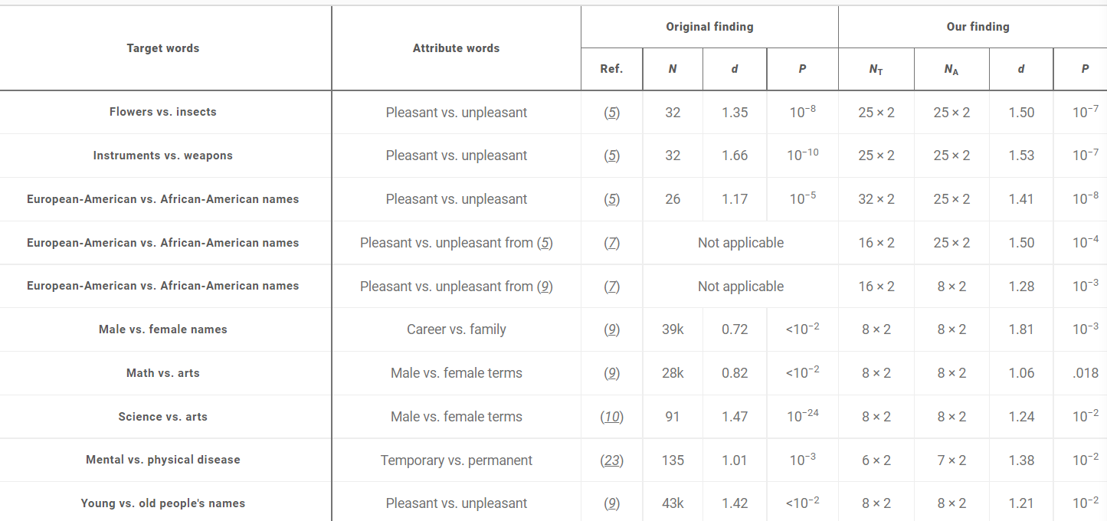
WEAT

Slide 20
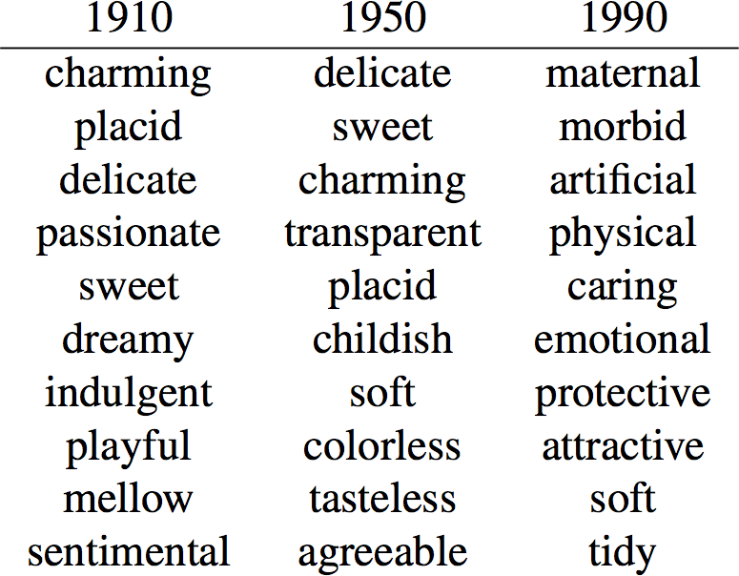
Gender biases are historical
Garg, Schiebinger, Jurafsky, Zou (2017) Word embeddings quantify 100 years of gender and ethnic stereotypes:
9

Slide 21
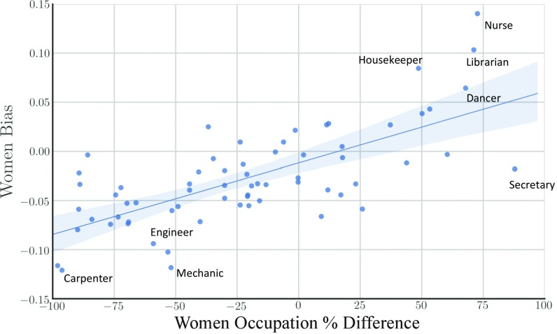
Another View

Slide 22
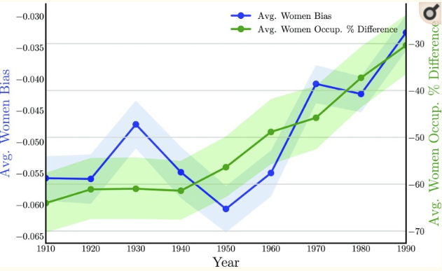
... By Time

Slide 23
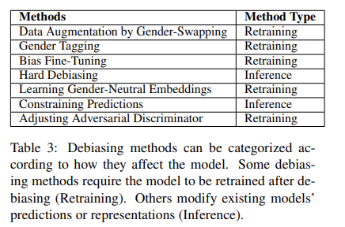
Mitigating Gender Bias in NLP
Debias training data
Data augmentation by swapping gender in text samples
Debiasing gender in word embeddings
Removing gender subspace
Train a gender-neutral embedding
isolate gender information in some dims: maximize difference between the gender dimension in male and female definitional word embeddings
maintain gender-neutral information in other dimensions: maximize the difference between the gender direction and the other neutral dimensions in the word embeddings
https://arxiv.org/abs/1906.08976
Notes:
https://arxiv.org/abs/1906.08976

Slide 24
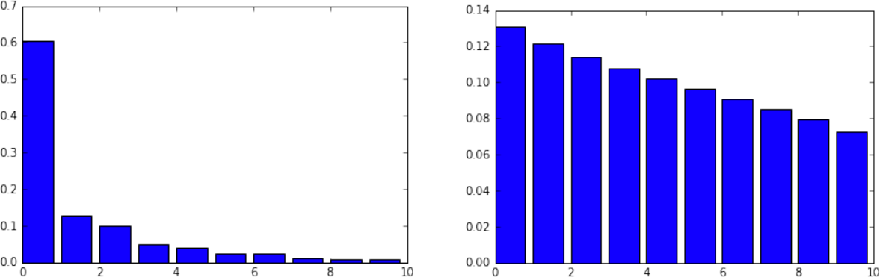
Identifying the gender subspace
Top 10 Eigenvalue Top 10 Eigenvalue
PCA ( “he”- “she”, “father”-”mother”,…)
PCA ( “dog”- “cat”, “house”-”building”,…)
Gender Pair
Random Pair
Kai-Wei Chang (kwchang.net/talks/sp.html)
Notes:
The first eigenvalue is significantly larger than the rest. Note that, from the randomness in a finite sample of ten noisy vectors, one expects a decrease in eigenvalues.
The decrease one observes due to random sampling is much more gradual and uniform.
Therefore we hypothesize that the top PC, denoted by the unit vector g, captures the gender subspace

Slide 25

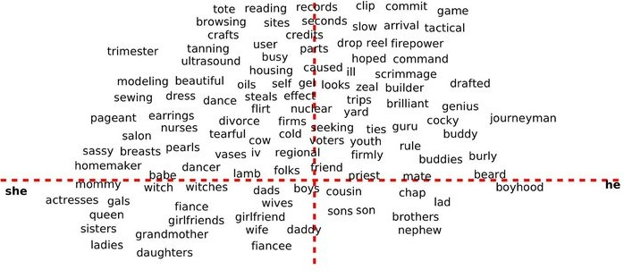
Reducing Gender Bias
SEXIST
FEMALE
MALE
DEFINITIONAL

Slide 26
Reducing Gender Bias
SEXIST
tote browsing tanning scrimmage dress sewing brilliant nurse cocky genius
homemaker
FEMALE
MALE
DEFINITIONAL

Slide 27
SENTIMENT ANALYSIS

Slide 28
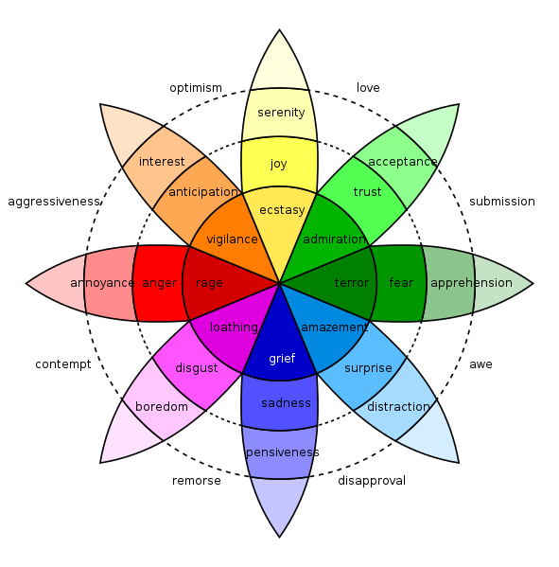
Measuring emotion in language
Emotions are psychological states brought on by thoughts, feelings, behavioural responses, and a degree of pleasure or displeasure.
E.g., happiness, sadness, surprise, disgust, anger, and fear.
Positive & negative emotions
Can we predict them from text?

Slide 29
Dictionary-based Sentiment Analysis
LIWC: dictionary approach
Words annotated with over 80 psychological categories, including positive and negative sentiment
WKB lexicon
14,000 English words annotated with emotional valence (positivity/negativity) and arousal (strength of emotion).
Also exists in Spanish
SentiStrength
Positive and negative sentiment
Vader
Valence Aware Dictionary for sEntiment Reasoning

Slide 30
Measuring emotions: Warriner’s (WKB) lexicon
Sentiment lexicon
Three dimensions of emotion
Valence
Arousal
Dominance
Collected emotional ratings for 14,000 words, the majority of the well-known English content words
Participants recruited through Amazon Mechanical Turk
shown lists of 350 words, including 10 calibrator words
asked to rate each word along 3 dimensions using a 9 pt scale
[Wariner et el., (2013) “Norms of valence, arousal, and dominance for 13,915 English lemmas”, ]

Slide 31
How do you feel while reading each word?
Valence
9: Happy, pleased, satisfied, contented, hopeful
1: Unhappy, annoyed, melancholic, despaired, or bored
Arousal
9: Excited, stimulated, excited, frenzied, jittery, wide-awake
1: Calm, relaxed, sluggish, dull, sleepy, or unaroused
5: Neutral, neither happy nor sad [not excited nor at all calm; neither in control nor controlled]

Slide 32
 | Valence |  | Arousal |  | Dominance
Lowest | pedophile | 1.26 | grain | 1.60 | dementia | 1.68
 | rapist | 1.30 | dull | 1.67 | Alzheimer’s | 2.00
 | AIDS | 1.33 | calm | 1.67 | lobotomy | 2.00
 | leukemia | 1.47 | librarian | 1.75 | earthquake | 2.14
 | molester | 1.48 | soothing | 1.91 | uncontrollable | 2.18
 | murder | 1.48 | scene | 1.95 | rapist | 2.21
Highest | excited | 8.11 | motherfucker | 7.33 | rejoice | 7.68
 | sunshine | 8.14 | erection | 7.37 | successful | 7.71
 | relaxing | 8.19 | terrorism | 7.42 | smile | 7.72
 | lovable | 8.26 | lover | 7.45 | completion | 7.73
 | fantastic | 8.36 | rampage | 7.57 | self | 7.74
 | happiness | 8.48 | insanity | 7.79 | incredible | 7.74

Slide 33
VADER
gold-standard sentiment lexicon that is especially attuned to microblog-like contexts.
Rules for grammatical and syntactical conventions that humans use when expressing or emphasizing sentiment intensity
Performs well on social media posts (better than LIWC)

Slide 34
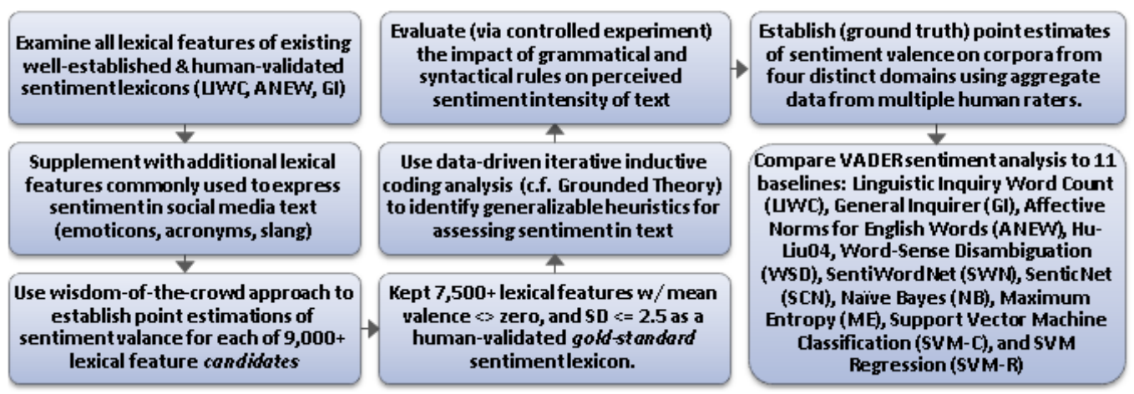
VADER

Slide 35
Global mood patterns
“Diurnal and seasonal moods vary with work, sleep and daylength across diverse cultures” by Golder and Macy
Can automated sentiment analysis be applied to social media data to provide a global picture of human mood?
Does mood have a time scale? Seasonal patterns?
Data
Up to 400 public messages from each user, 509 million messages total
2.4 million individuals worldwide (84 identified countries)
English only
Date, Time, and country latitude

Slide 36
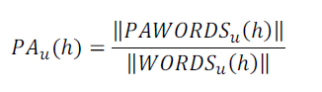
Methodology
Examined within-individual Positive Affect (PA) and Negative Affect (NA) independently,
E.g., fraction of PA words appearing in an individual’s messages every hour
To eliminate between-individual variation, subtract the mean: PA_{u}*(h) = PA_{u}(h) - <PA_{u}(h)>
Additional analysis on 4 English-speaking regions: Africa, India, UK/Aus, US/Can

Slide 37
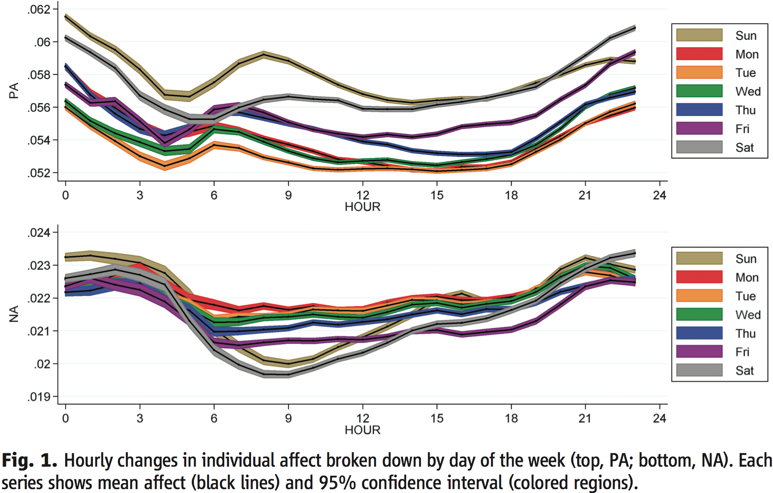
Two peaks in Positive Affect daily; Positive Affect is higher on weekends

Slide 38
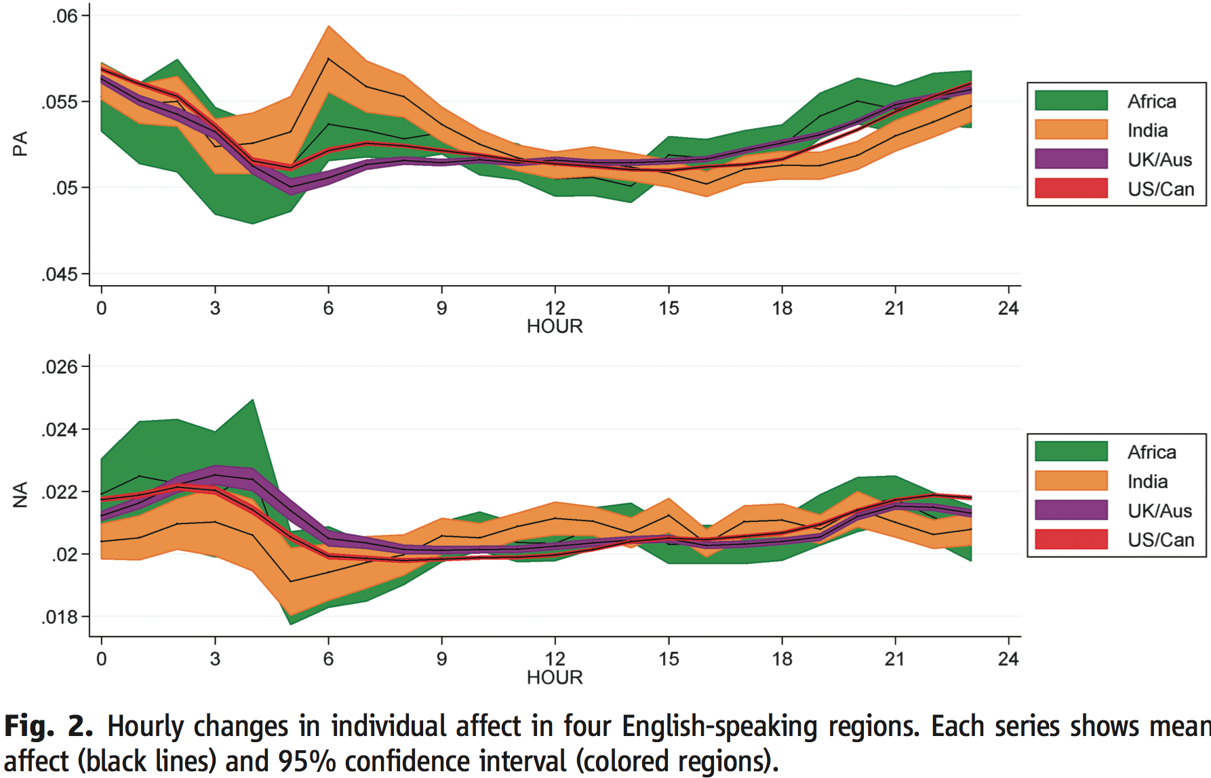
Mood governed by diurnal cycles, not culture

Slide 39
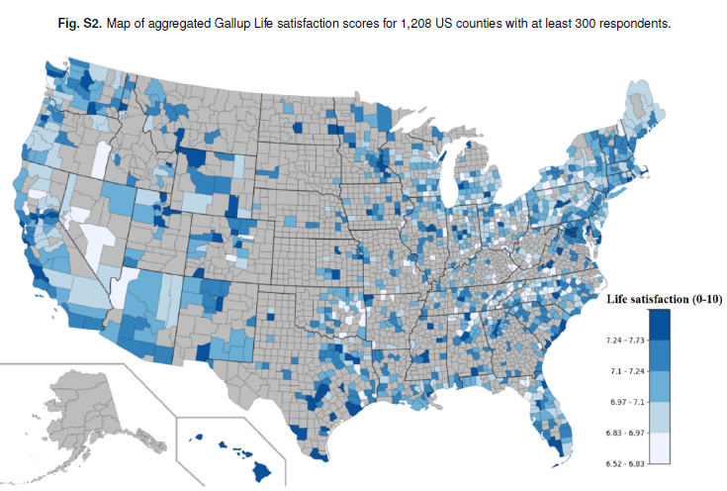
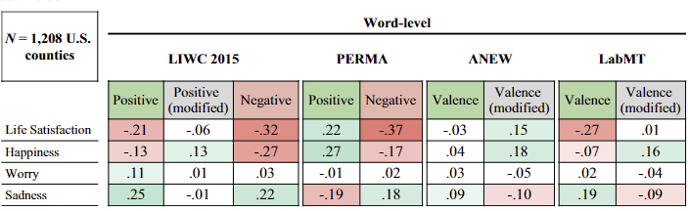
Can we use Twitter data to monitor happiness?
Jaidka et al (2020). Estimating geographic subjective well-being from Twitter: A comparison of dictionary and data-driven language methods. PNAS, 117(19), 10165-10171.
Is it possible to spatially aggregate Twitter messages to monitor the subjective well-being of populations on a large scale?
Dictionary-based sentiment methods yield inconsistent county-level well-being measurements due to regional, cultural, and socioeconomic differences in language use.

Slide 40
Creating a racist sentiment classifier
http://blog.conceptnet.io/posts/2017/how-to-make-a-racist-ai-without-really-trying/
Use pre-trained word embeddings to represent the meanings of words
GLOVE
Acquire ground truth data for use in training and testing the algorithm
6800 positive and negative words
http://www.cs.uic.edu/~liub/FBS/opinion-lexicon-English.rar
Train a classifier, using gradient descent, to recognize other positive and negative words based on their word embeddings
95% accuracy on words not in training data
Generalizes to words not in the ground
Compute sentiment scores for sentences of text using this classifier

Slide 41
sentiment
fidget | -9.931679
interrupt | -9.634706
staunchly | 1.466919
imaginary | -2.989215
taxing | 0.468522
world-famous | 6.908561
low-cost | 9.237223
disapointment | -8.737182
totalitarian | -10.851580
bellicose | -8.328674
freezes | -8.456981
sin | -7.839670
fragile | -4.018289
fooled | -4.309344
undecided | -2.816172
handily | 2.339609
demonizes | -2.102152
easygoing | 8.747150
unpopular | -7.887475
commiserate | 1.790899

Slide 42
Let’s analyze the sentiment of some texts
Restaurants
text_to_sentiment("Let's go get Italian food“) 🡪 2.043
text_to_sentiment("Let's go get Chinese food") 🡪 1.409
text_to_sentiment("Let's go get Mexican food") 🡪 0.388
Names
mohammed | 0.834974 | Arab/Muslim
alya | 3.916803 | Arab/Muslim
terryl | -2.858010 | Black
josé | 0.432956 | Hispanic
luciana | 1.086073 | Hispanic
hank | 0.391858 | White
megan | 2.158679 | White

Slide 43
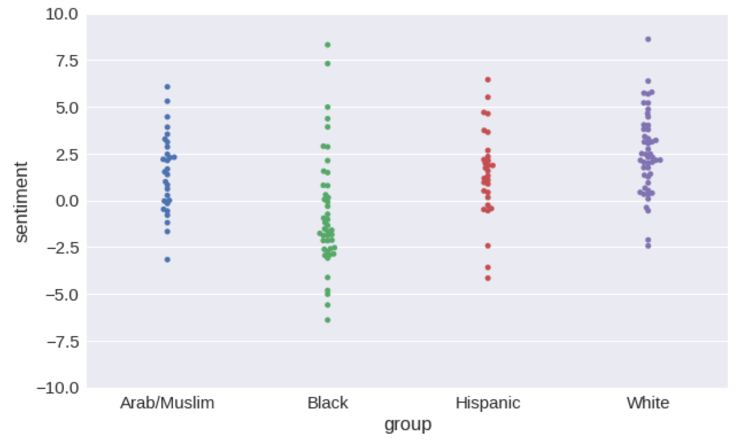
Sentiment of names

Slide 44
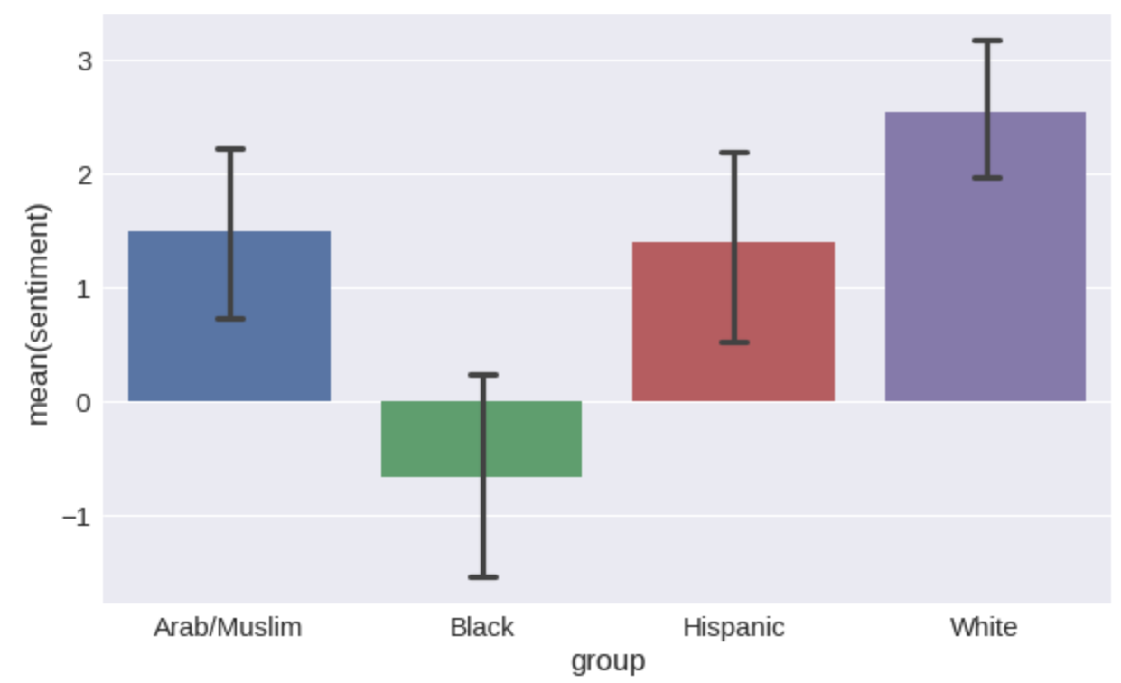

Slide 45
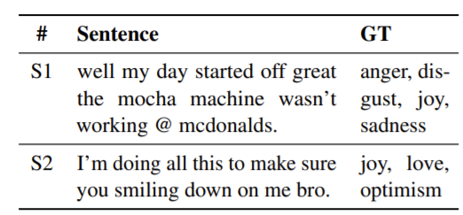
Language models for emotion recognition
learn association between emotion labels and words in a sentence
emotions are not independent; a specific emotive expression can be associated with multiple emotions
E.g., Plutchik’s wheels of emotion: “joy” is close to “love” and “optimism”, instead of “anger” and “sadness”
Example Tweets from SemEval-18 Task 1. GT represents the ground truth labels
Casting Multi-label Emotion Classification as Span-prediction
https://arxiv.org/abs/2101.10038

Slide 46
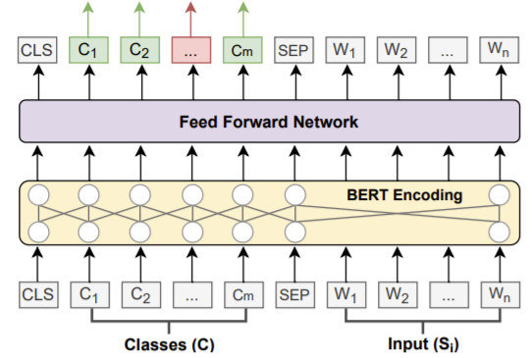
SpanEmo: language model for recognizing emotions
Given an input sentence and a set of classes, a base encoder was employed to learn contextualised word representations.
Feeding both segments to the encoder allows it to interpolate between emotion classes and words in the input sentence
feed forward network (FFN) was used to project the learned representations into a single score for each token
use the scores for the label tokens as predictions for the corresponding emotion label.

Slide 47
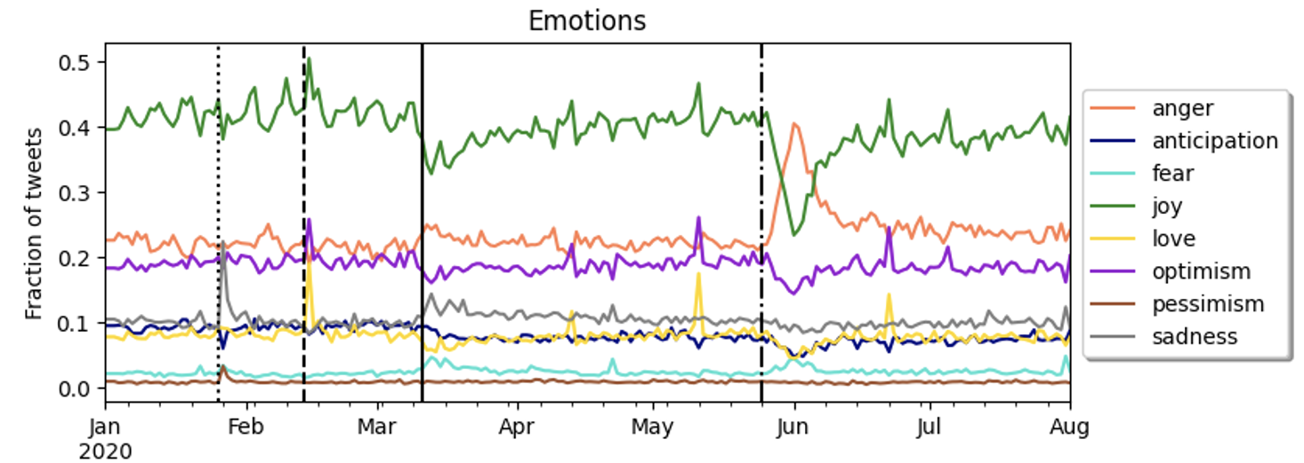
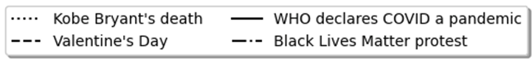
Emotions during the Covid-19 pandemic in LA

Slide 48
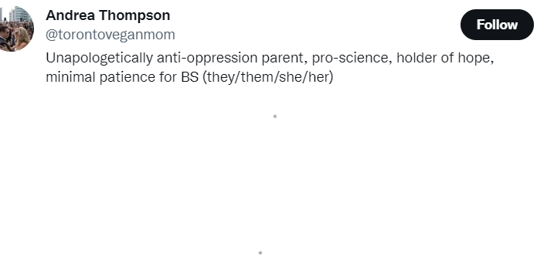
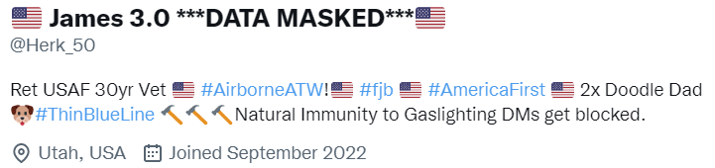
Identity Online
Individual and group identities are formed online through individual expression and group interactions.
Username, profile is how they present themselves online
How does identity is associated with how emotions are expressed in tweets?
E.g., users present their gender identity by listing their pronouns

Slide 49
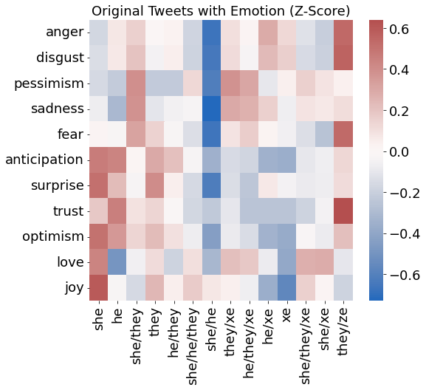
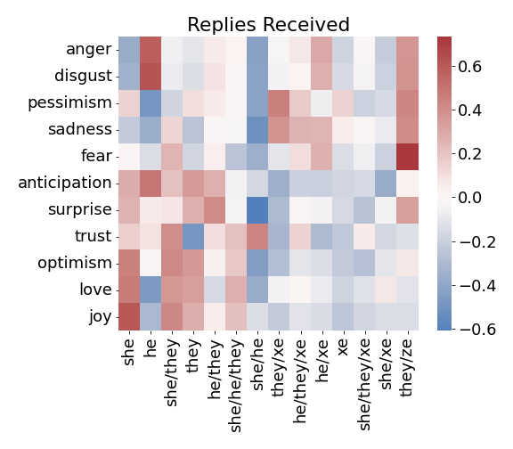
Gender identity* and emotions on Twitter
Expression: Emotions expressed by gender groups
Climate: Emotions in response to different gender groups
* Based on pronouns user declared in their Twitter profile

Slide 50
Gender identity* and emotions on Twitter
Expression: Emotions expressed by gender groups
Climate: Emotions in response to different gender groups
Non-traditional gender groups express more negative emotions
Traditional gender groups express more positive emotions
more positive climate
less positive climate

